Slide 1

Analyzing Community Areas IN Chicago to start a new restaurant
Kerry Goode, Jr
IBM Applied Data Science Capstone
06/06/21

Slide 2

Introduction
Chicago: the most populated city in the State of Illinois
Estimated population of 2.6 million people in 2019
The most populated city in the Midwestern United States.
The fifth most populated city in North America.
This Photo by Unknown Author is licensed under CC BY-SA-NC

Slide 3

Business Problem
Starting a restaurant in Chicago
Community Area that is the most likely to give good business.
This Photo by Unknown Author is licensed under CC BY-NC

Slide 4
Data
Community Areas of Chicago
Community Areas of Chicago Wikipedia page through data scaping
Geographical coordinates of the Community areas
Using GeoPy library
Venue Data from FourSquare
Using FourSquare API

Slide 5
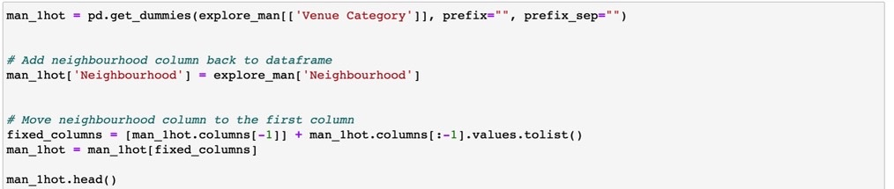
Methodology
Feature Extraction
One Hot Coding

Slide 6
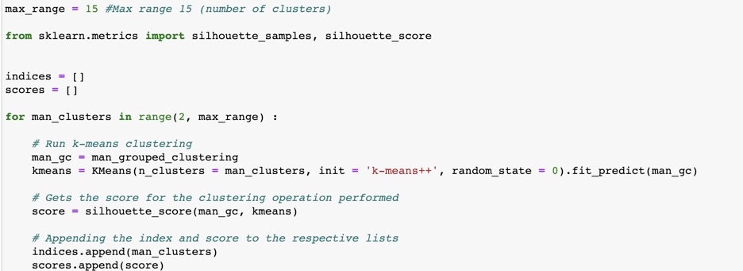
Unsupervised Learning
K-means Clustering

Slide 7
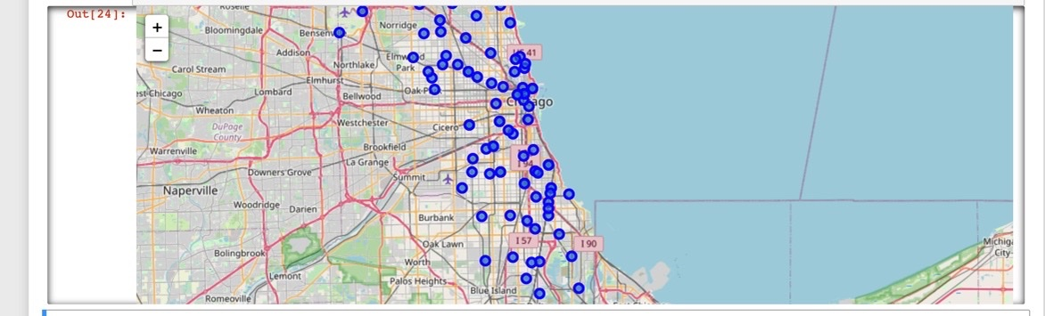
Plotting
Folium

Slide 8
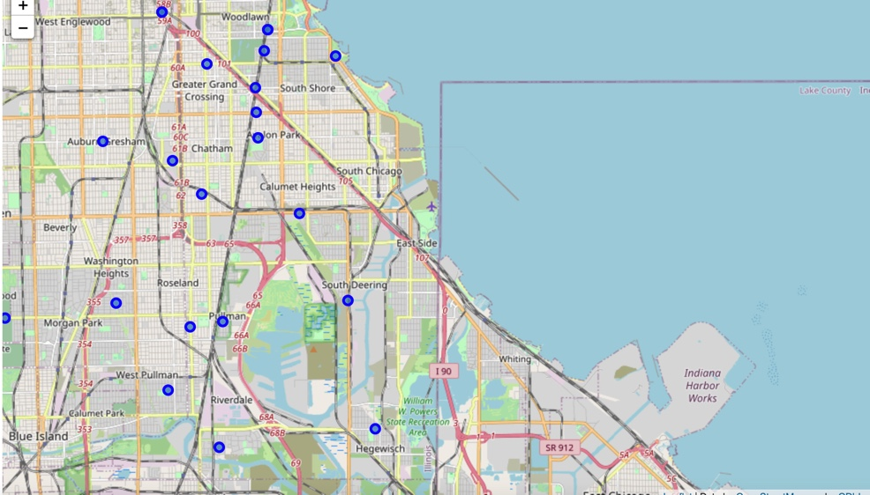
Results
Visualization of Clusters
After visualizing the clusters, each cluster was studied, and a conclusion was derived.
The community area that had the greatest number of restaurants was cluster 4.

Slide 9
Discussion
The most suitable Neighborhoods for starting a restaurant are in cluster 4.
The K-means model successfully clustered similar neighborhoods.
The community areas such as West Loop, River North, and Pilsen are good locations

Slide 10

Conclusion
In this project, the community areas of Chicago were studied and a recommendation of the community areas where our client should start their franchise was provided.

